Slide 1
Memory Management Techniques
Inverted Paging
prepared by Group 1:
On Wu Xu 2290113-DCS
Lim Yee Jie 2290025-DCS
Yap Kah Seng 2290146-DCS
Huai Zi Yao 2290085-DCS
Tan Thee Wei 2290107-DCS
Lee Mun Hinn 2270117-DCS

Slide 2
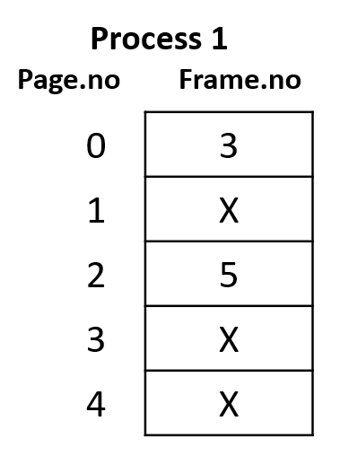
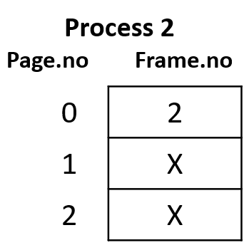
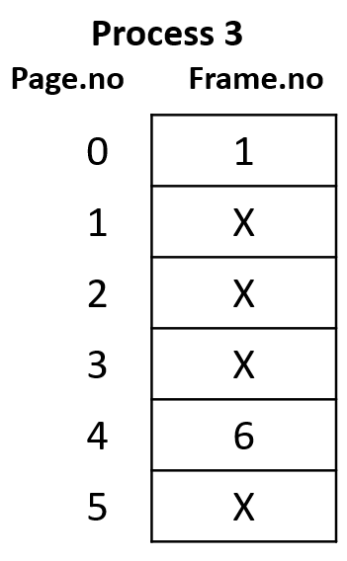
Paging Table
Memory

Slide 3
Inverted Page Table
Frame.no | Page.no | ProcessID
0 | X | X
1 | 0 | P3
2 | 0 | P2
3 | 0 | P1
4 | X | X
5 | 3 | P1
6 | 4 | P3
Memory

Slide 4
Working
In inverted page table indexing is done with frame numbers instead of the logical page number. Each entry in the page table contains the following fields.
Frame No: It specifies the Frame where the page no is actually present in main memory
Page number: It specifies the page number which is required.
Process id: An inverted page table contains pages of all the processes in execution. So page No may be same of different process but Process Id of each process is unique. Through Process ID we get the desired page of that process.
Control bits –These bits are used to store paging table entry information. These include the valid/invalid bit, protection, dirty bit, reference bits, and other information bit.
Chained pointer:It is possible when two or more processes share some part of main memory. In simple words, when two or more logical pages need to map to same Page Table Entry then a chaining pointer is used.

Slide 5
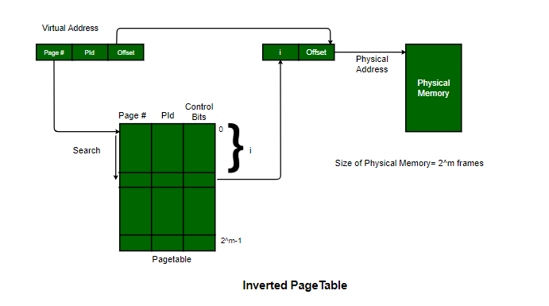
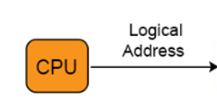
Cpu generate一个Logical Address , 里面有 Process ID , page number 和 offset
Virtual address的PiD会用于Map/search 整个page table
当PiD和Page Number都匹配，就表示找到了想要的Data
然后通过这个data的上方共有多少个frame来计算出i的值 （其实就是data本身的frame No ，不需要算），比如frameNo3的上面是 0,1,2(也就是3个frame,其实都一样)
通过这个i和CPU generate的offset组成一个东西来去 Physical Memory找data了

Slide 6
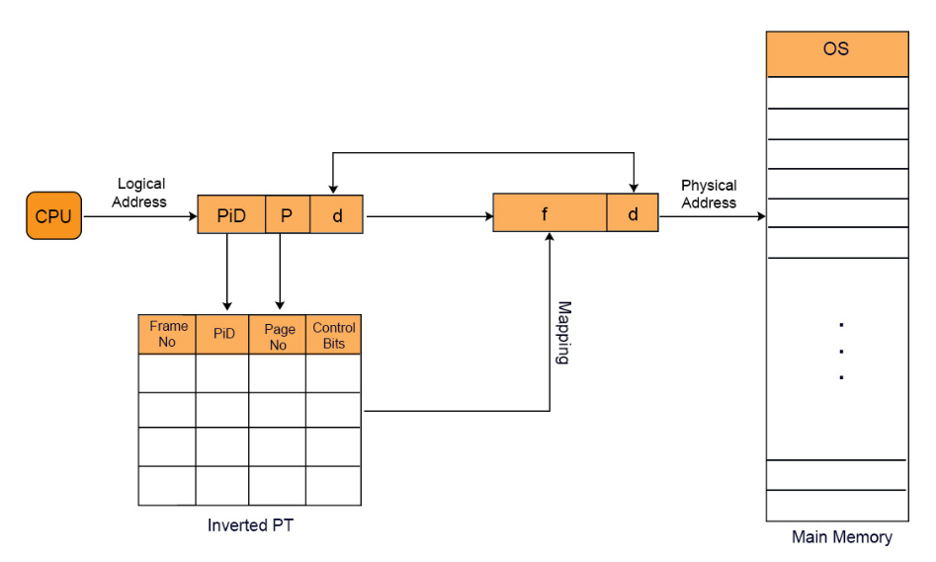

Slide 7
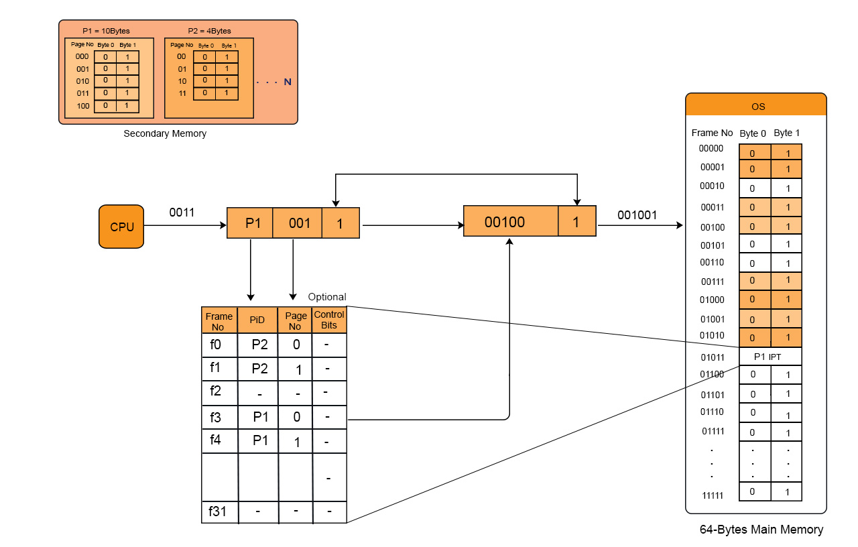


PiD PageNo d(offset)
Frame No d
(f3)
Search
假设我找到的数据的frame no为3，也就是 00100 ，去到main memory也是通过00100找到对应的Frame No 00100

